Slide 1
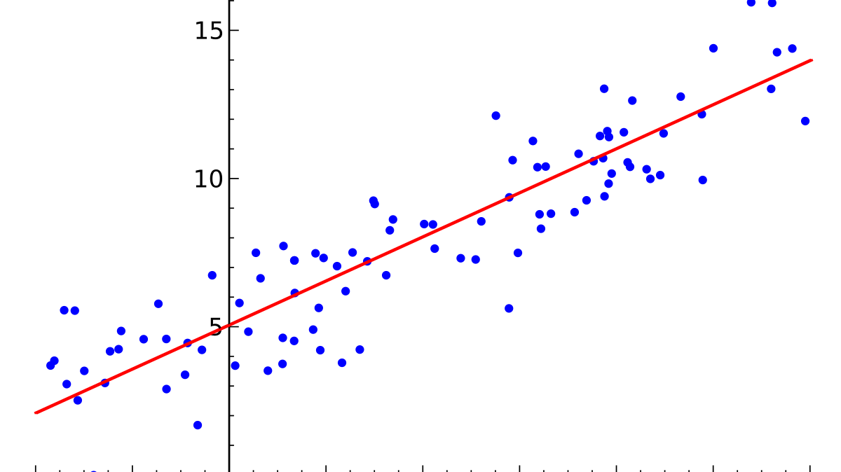
REGRESSION MODELS
SIMPLE & MULTIPLE LINEAR REGRESSIONS
LOGISTIC REGRESSIONS

Slide 2
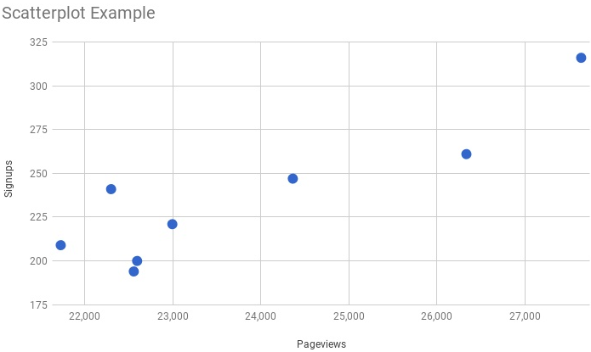
Scatter plot
A scatter plot is a two-dimensional data visualization that uses dots to represent the values obtained for two different variables - one plotted along the x-axis and the other plotted along the y-axis.

Slide 3
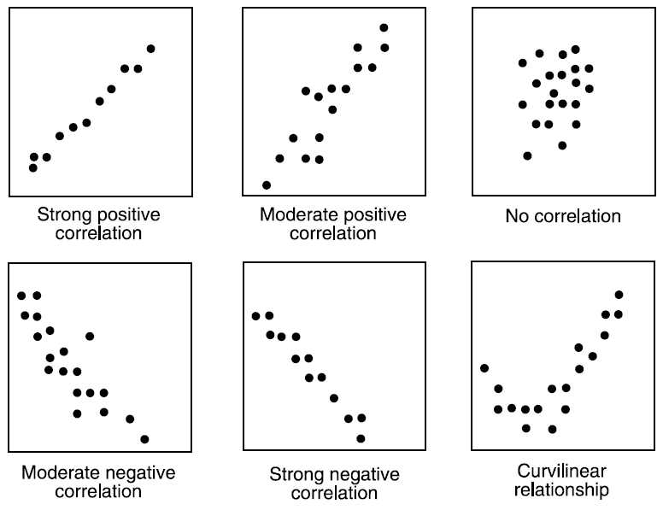
Scatter plot
Correlation doesn’t guarantee causation by itself doesn’t imply a cause and effect relationship.
Judge the strength of a relationship by width or tightness of scatter
Determine direction of the relationship,
E.g., If X decreases and Y decreases, it is negative correlation limiting if X increases and Y increases.

Slide 4
Correlation Analysis
Correlation Analysis measures the degree of linear relationship between two variables.
If the absolute value of the correlation coefficient is greater than 0.85, then we say there is a good relationship.
Example: r=0.87, r=-0.9, r=0.9, r=-0.87 describes good relationship.
r=0.5, r=-0.5,r=0.28 describes poor relationship
Perfect positive relationship | +1
Perfect negative relationship | -1
No linear relationship | 0

Slide 5
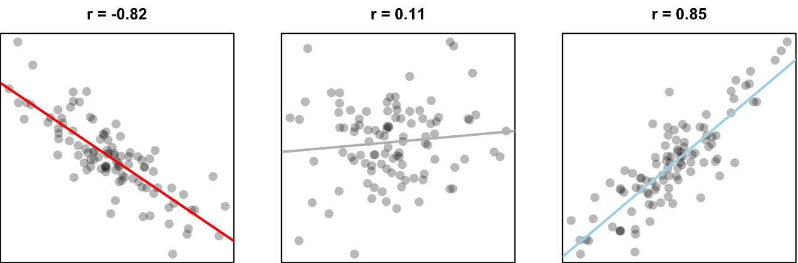
Correlation Analysis
Correlation values of -1 to +1 imply an exact linear relationship. However, the real value of correlation is in quantifying less than perfect relationship.
We can perform regression analysis, which attempts to further describe this type of relationship, if the correlation between the variables.

Slide 6
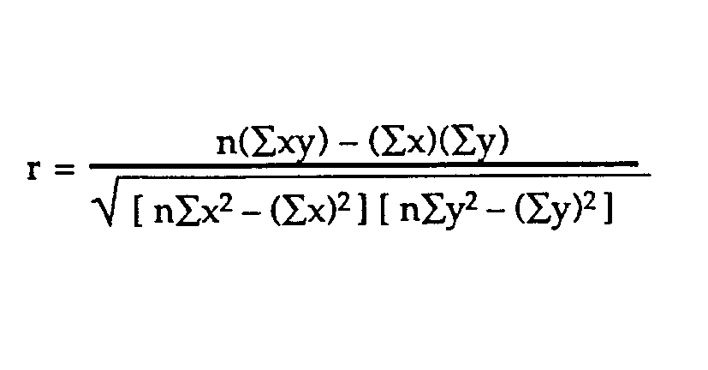
Correlation Analysis

Slide 7
Linear Regression

Slide 8
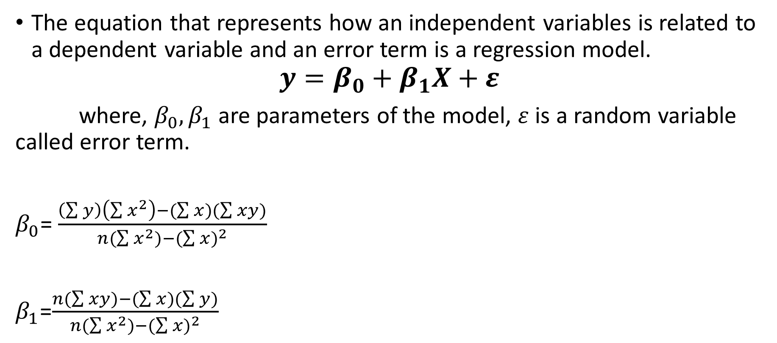
Linear Regression Model
The equation that represents how an independent variables is related to a dependent variable and an error term is a regression model.
$$y=β_{0}+β_{1}X+ε$$
where, $β_{0},β_{1}$ are parameters of the model, $ε$ is a random variable called error term.
$β_{0}$= $\frac{\left(\sum{y}\right)\left(\sum{x^{2}}\right)−(\sum{x})(\sum{xy)}}{n(\sum{x^{2})−}{(\sum{x})}^{2}}$
$β_{1}$=$\frac{n(\sum{xy)−(\sum{x})(\sum{y})}}{n(\sum{x^{2})−{(\sum{x})}^{2}}}$

Slide 9
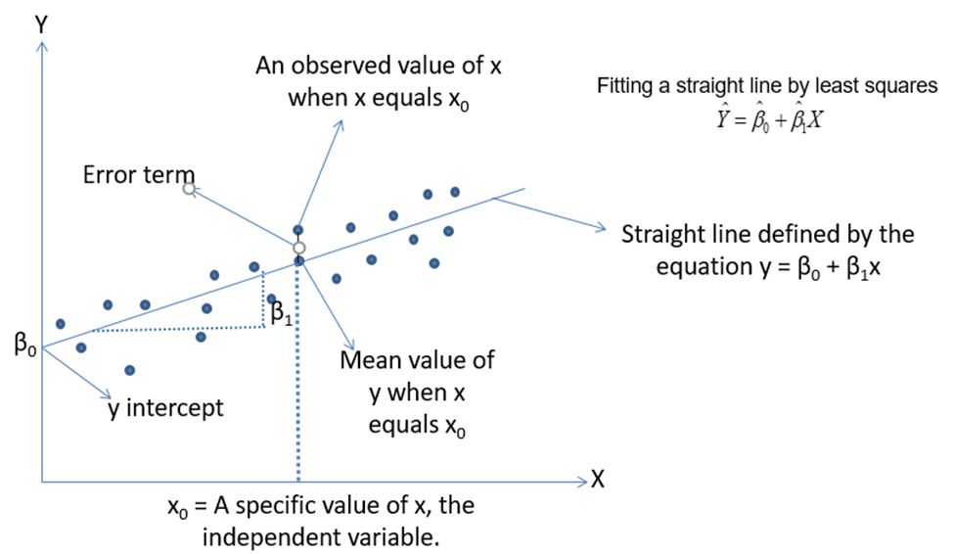
Linear Regression Model

Slide 10
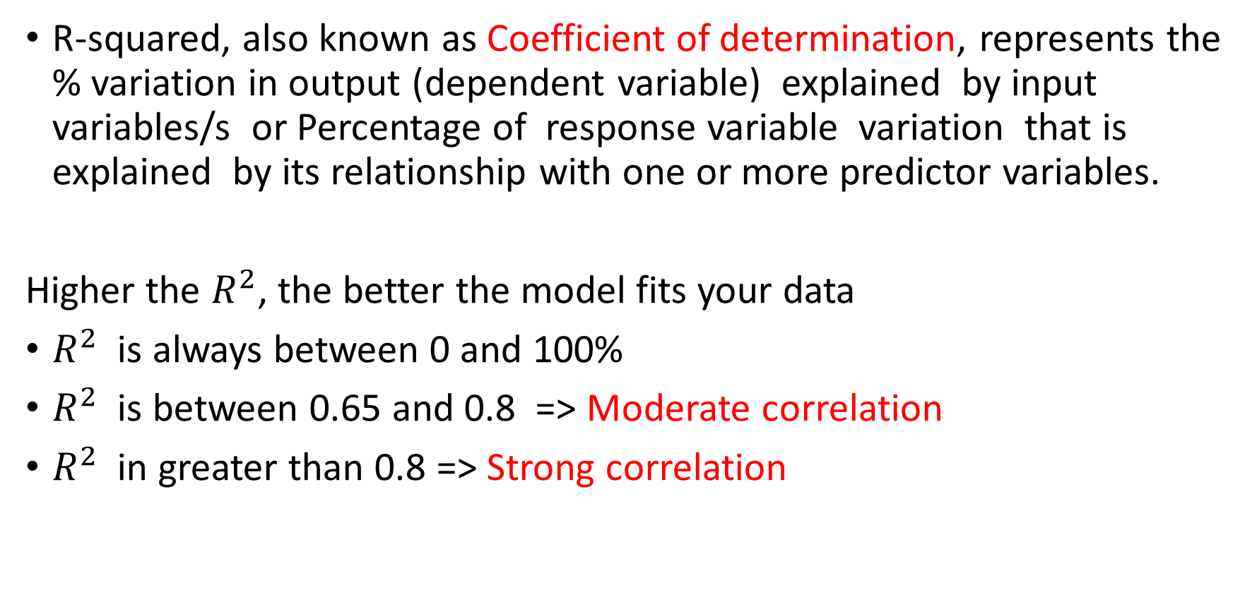
Regression Analysis
R-squared, also known as Coefficient of determination, represents the % variation in output (dependent variable) explained by input variables/s or Percentage of response variable variation that is explained by its relationship with one or more predictor variables.
Higher the $R^{2}$, the better the model fits your data
$R^{2}$ is always between 0 and 100%
$R^{2}$ is between 0.65 and 0.8 => Moderate correlation
$R^{2}$ in greater than 0.8 => Strong correlation

Slide 11
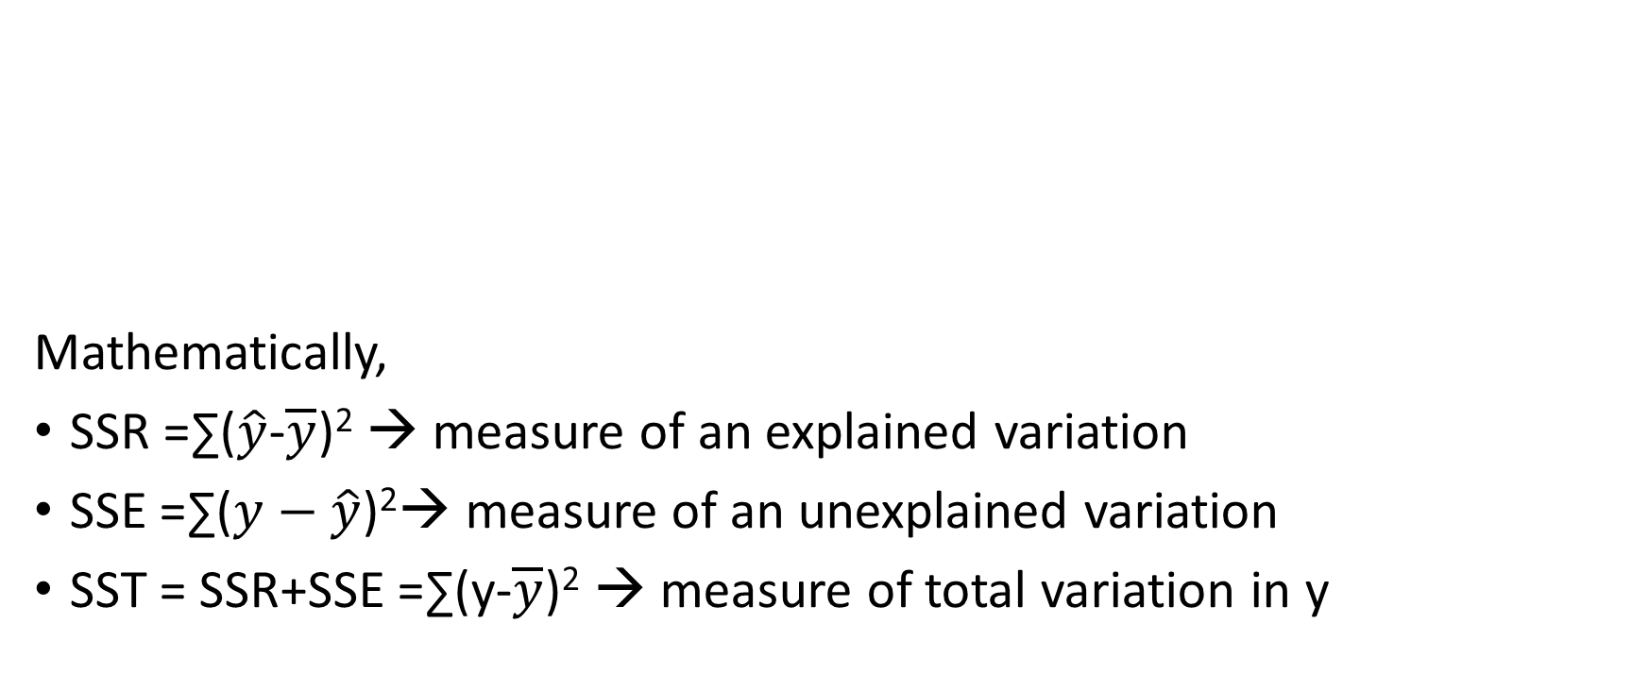
Regression Analysis
Mathematically,
SSR =∑($\hat{y}$-$\overline{y}$)² → measure of an explained variation
SSE =∑($y−\hat{y}$)²→ measure of an unexplained variation
SST = SSR+SSE =∑(y-$\overline{y}$)² → measure of total variation in y
R²=SSR/SST= (SSR/(SSR+SSE))
0<=R²<=1

Slide 12
Regression Analysis
Prediction and Confidence Interval are types of confidence intervals used for predictions in regression and other linear models:
Prediction Interval: Represents a range that a single new observation is likely to fall given specified settings of the predictors
Confidence interval of the prediction: Represents a range that the mean response is likely to fall given specified settings of the predictors.
The prediction interval is always wider than the corresponding confidence interval because of the added uncertainty involved in predicting a single response versus the mean response

Slide 13
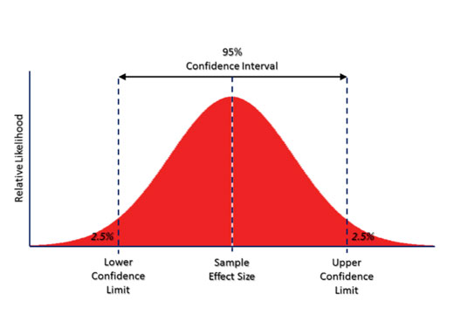
Regression Analysis

Slide 14
Regression Techniques- Simple Linear Regression
Y=Continuous
X=Single & Continuous
Simple Linear Regression
Y=Continuous
X= Simple & discrete
Simple Linear Regression
Create Dummy Variable

Slide 15
Simple Linear Regression - R
A business problem: The Waist Circumference – Adipose Tissue data.
Studies have shown that individuals with excess Adipose tissue (AT) in the abdominal region have a higher risk of cardio-vascular diseases.
Computed Tomography, commonly called the CT Scan is the only technique that allows for the precise and reliable measurement of the AT (at any site in the body)
The problems with using the CT scan are:
Many physicians do not have access to this technology
Irradiation of the patient (suppresses the immune system)
Expensive

Slide 16
Simple Linear Regression - R
Is there a simpler yet reasonably accurate way to predict the AT area? i.e.,
Easily available
Risk free
Inexpensive
A group of researchers conducted a study with the aim of predicting abdominal AT area using simple anthropometric measurements, i.e., measurements on the human body
The Waist Circumference – Adipose Tissue data is a part of this study wherein the aim is to study how well waist circumference (WC) predicts the AT area

Slide 17
Regression Techniques- Multiple Linear Regression
Y=Continuous
X=Multiple & Continuous
Multiple Linear Regression
Y=Continuous
X= Multiple & discrete
Multiple Linear Regression
Create Dummy Variable

Slide 18
Multiple Linear Regression- Dummy Variable
Make of Car | Dummy Variable Petrol | Dummy Variable Diesel | Dummy Variable CNG | Dummy Variable LPG
Petrol | 1 | 0 | 0 | 0
Diesel | 0 | 1 | 0 | 0
CNG | 0 | 0 | 1 | 0
LPG | 0 | 0 | 0 | 1
Diesel | 0 | 1 | 0 | 0
CNG | 0 | 0 | 1 | 0
Petrol | 1 | 0 | 0 | 0
LPG | 0 | 0 | 0 | 1
Petrol | 1 | 0 | 0 | 0
CNG | 0 | 0 | 1 | 0

Slide 19
Multiple Regression Model- R
DATA : CARS, 81 observations, “cars.csv”
VOL = cubic feet of cab space
HP = engine horsepower
MPG = average miles per gallon
SP = top speed, miles per hour
WT = vehicle weight, hundreds of pounds
Our interest is to model the MPG of a car based on the other variables.

Slide 20
Model and Assumptions
Linearity (Assumptions about the form of the model):
Linear in parameters
Assumptions about the errors:
IID Normal (Independently & identically distributed)
Zero mean
Constant variance (Homoscedasticity)
If no constant variance (Heteroscedasticity)
Independent of each other. If not independent, it is called as Auto Correlation problem.
$$Y=β_{0}+β_{1}X_{1}+β_{2}X_{2}+β_{3}X_{3}+…+β_{k}X_{k}+ε$$

Slide 21
Model and Assumptions
Assumptions about the predictors:
Non-random
Measured without error
Linearly independent of each other. If not, it is called as Collinearity problem.
Assumptions about the observations:
Equally reliable

Slide 22
Logistic Regression

Slide 23
Techniques used for Attribute Analysis
Logistic Regression
Logit Analysis
Probit Analysis

Slide 24
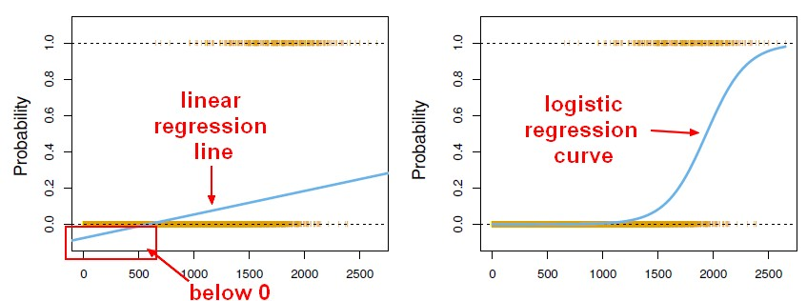
Logistic Regression
Logistic regression predicts the probability associated with each dependent variable category.
It finds the linear relationship between independent variable and a link function of this probabilities. Then, the link function that provides the best goodness-of-fit for the given data is chosen.

Slide 25
Types of Logistic Regression
Logistic Regression
Simple
Multiple

Slide 26
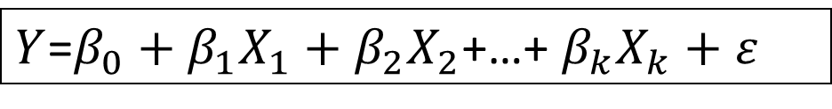
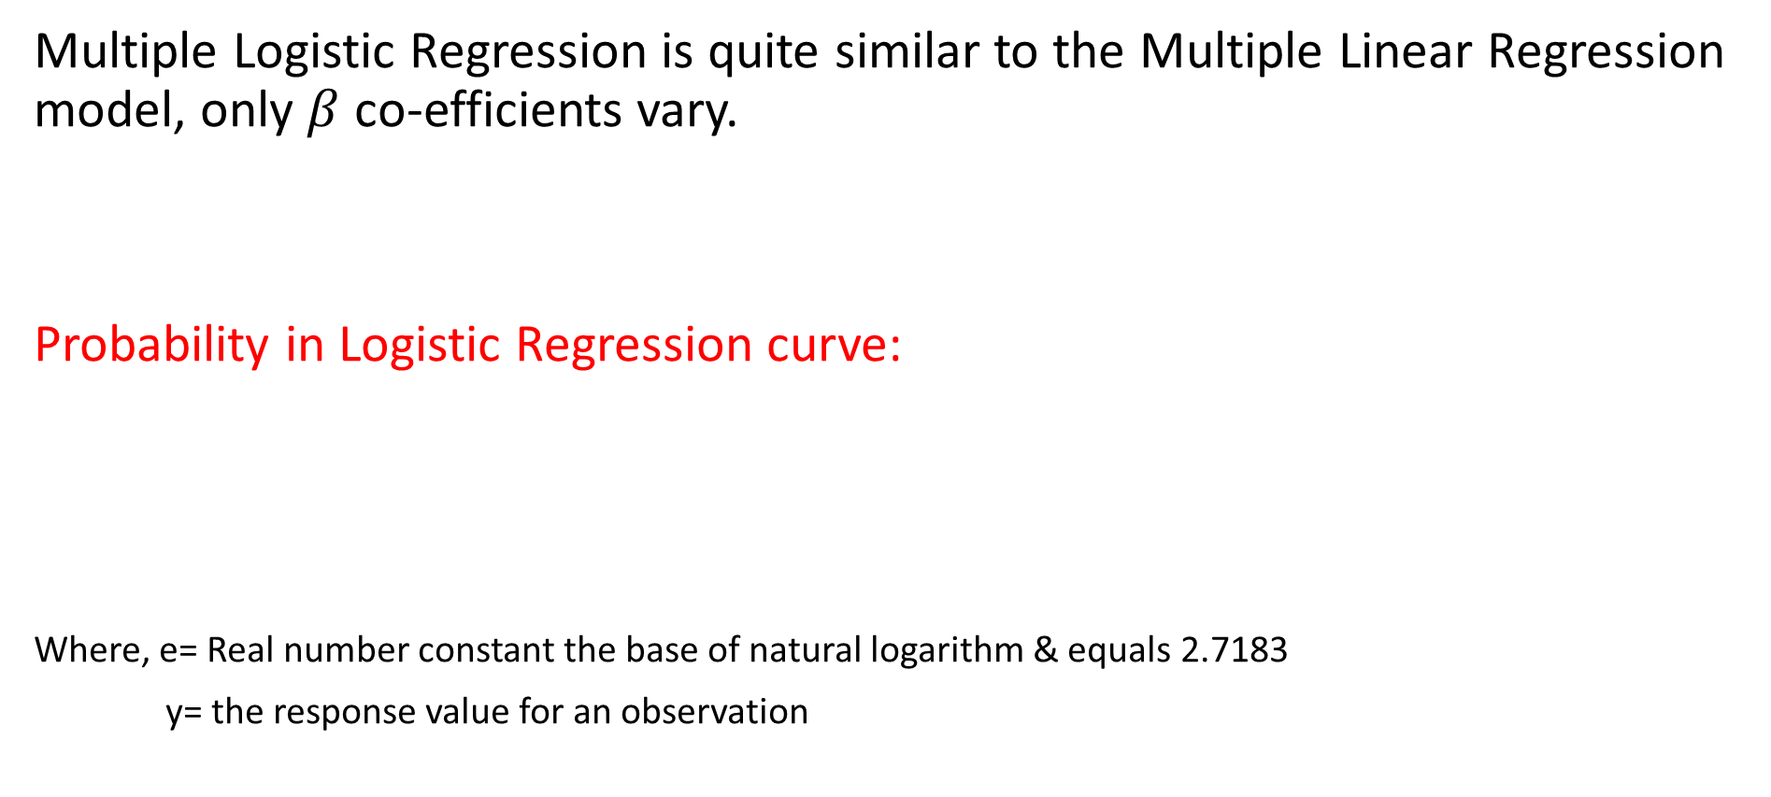

Multiple Logistic Regression
Multiple Logistic Regression is quite similar to the Multiple Linear Regression model, only $β$ co-efficients vary.
Probability in Logistic Regression curve:
Where, e= Real number constant the base of natural logarithm & equals 2.7183
y= the response value for an observation
$Y$=$β_{0}+β_{1}X_{1}+β_{2}X_{2}$+…+ $β_{k}X_{k}+ε$
$$p=\frac{e^{y}}{1+e^{y}}$$

Slide 27
Types of Methods
There are three methods of Logistic Regression based on the nature of the attribute data:
Binary Logistic Regression is performed on the binary response variables. It has only two categories, such as presence or absence of disease, pass or fail, defective or non-defective products.
Nominal Logistic Regression is performed on the nominal variables. These are categorical variable that have three or more possible categories with no natural ordering.
Ordinal Logistic Regression is performed on ordinal response variables. These are categorical variable that have three or more possible categories with a natural ordering.

Slide 28
Types of Methods
Method | Description of categorical response variable | Example
Binary | Two categories | Presence/Absence of disease
Nominal | Three or more categories with no natural ordering to the levels | Crunchy/mushy/crispy
Ordinal | Three or more categories with ordering of the levels | Strongly disagree/ disagree/ neutral/ agree/ strongly agree

Slide 29
Model and Assumptions
Only one outcome per event- like pass or fail.
The outcomes are statistically independent.
All relevant predictors are in the model.
One category at a time- means mutually exclusive and collectively exhaustive.
Sample size are larger than for linear regression.

Slide 30
Simple Logistic Regression- Example
Imagine that you are a Data Scientist at a very large-scale integration circuit manufacturing company. You want to know whether the time spent inspecting each product impacts the quality assurance department’s ability to detect a designing error in the circuit
Collect and organize the sample data
Number of Observations
Error Identification
Inspection Time
Number of Observations: 55 Observations of circuits with errors, and determine whether those errors were detected by QA

Slide 31
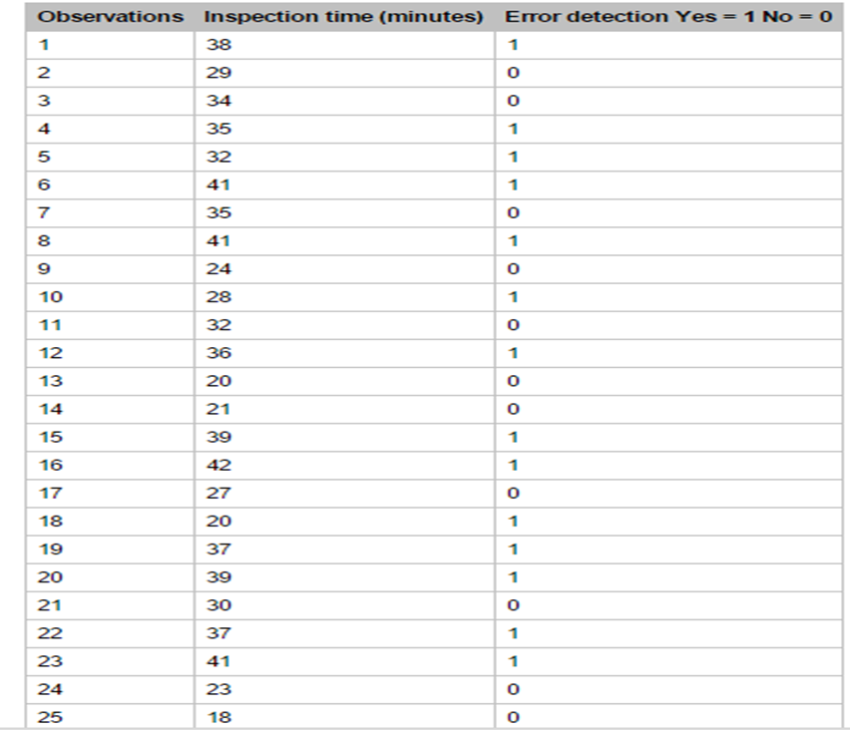

Slide 32
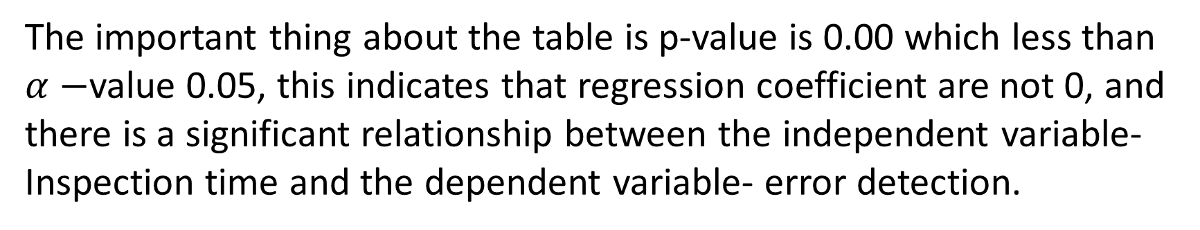
Example:
Predictor | Coef | SE Coef | Z Statistic | P-Value
Constant | -9.947 | 2.498 | -3.98 | 0.000
Inspection Time | 0.329 | 0.081 | 4.05 | 0.000
The important thing about the table is p-value is 0.00 which less than $α−$value 0.05, this indicates that regression coefficient are not 0, and there is a significant relationship between the independent variable- Inspection time and the dependent variable- error detection.

Slide 33

Example
Goodness-of-fit→ Pearson’s method
Chi-square Statistics= 7.6831
Degree of Freedom= 20
P-value= 0.608
P-value indicates that there’s insufficient evidence to reject the null hypothesis.
Determining Probabilities using Probability equation
$$p=\frac{e^{y}}{1+e^{y}}$$
e = 2.7183

Slide 34
Example
Logistics Regression equation:
y = -9.94645 + 0.328827x
y = -9.94645+(0.328827)(40)
y = 3.20663
p = e^{y} / (1 + e^{y )}
p = 2.7183^{3.2066} / (1+ 2.7183^{3.2066} )
p = 24.69572 / 25.69572
p = 0.9611 or 96.11%
Interpretation:
Probability 96.11% indicates that the error will be detected if QA spent 40 minutes of inspection during an observation.

Slide 35
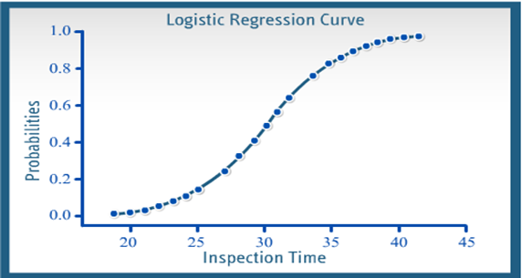
Example
Compile the results:

Slide 36
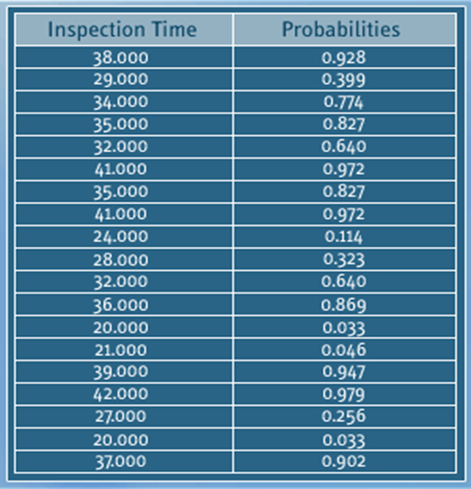
Example

Slide 37
Multiple Logistic Regression Model- R
DATA : Claimants, 1340 observations, “claimants.csv”
CASENUM = case number
ATTORNEY = has an attorney or no
CLMSEX = gender of the claimant
SEATBELT = had a seat belt or not
CLMAGE =age of claimant
LOSS = loss endured
Our interest is to model the ATTORNEY based on the other variables.

Slide 38
NEXT TOPIC> CLUSTER ANALYSIS

